Slide 1

Computer Science 212 Introduction to Computing and Cyber Operations
Lesson 28 - Intro to Machine Learning

Slide 2
Lesson Objectives
By the end of this lesson, you will be able to:
Describe the goals and motivation behind Machine Learning
Define common ML terminology, such as “model”, “instance”, and “feature”
Describe and differentiate between Supervised and Unsupervised learning
Describe and execute the steps involved in training a machine learning model
Analyze a confusion matrix in order to evaluate a model’s performance

Slide 3
HOMEWORK (I’m kidding… just for fun!)
Ex Machina (Strong AI)
Social Dilemma (Weak AI, but scary how they use it on us)
The Imitation Game (Origins of AI)
Moneyball (Machine Learning)

Slide 4
What is Machine Learning?
“A field of computer science that aims to teach computers how to learn and act without being explicitly programmed.”
“A program or system that builds (trains) a predictive model from input data. The system uses the learned model to make useful predictions from new (never-before-seen) data.
Machine Learning involves:
Algorithms that can derive rules / behaviors from large datasets without explicitly being told what they are
Datasets that are used to:
Train the computer
Verify that the computer has learned the correct concept
Human expertise in order to cultivate the datasets and verify that the algorithms are working as intended (i.e., learning the intended concept)
Machine Learning has experienced a resurgence due to:
(Availability) Increasing volume, variety, and velocity of data
(Storage) Decreases in bandwidth / storage costs
(Computational Power) Exponential increases in computational power at low prices

Slide 5
Terminology
Model
A software representation of what a machine learning system has learned from the training dataset.
Feature
One column in a dataset. It represents a value that can be used to make a prediction.
Label (sometimes referred to as a Class value)
Refers to the “answer” or “result” portion of an instance. It represents is the “concept” we are trying to train the model to classify.
Instance (i.e., “example”)
One row in a dataset. It represents a specific example the algorithm can learn from.
Features
Labels
waist | pushup | situp | run | result
40 | 36 | 55 | 676 | Unsat
42 | 67 | 25 | 798 | Unsat
30 | 44 | 58 | 568 | Ex
30 | 39 | 58 | 729 | Sat
37 | 46 | 57 | 709 | Sat
Y
Waist > 40
N
Instance
ML Algorithm
Unsat
Y
Run > 650
N
Sat
Ex
Dataset
Model

Slide 6
Unsupervised Learning
The machine learning algorithm is provided with an unlabeled dataset
Task: Group similar instances
It is up to a subject matter expert to determine if the # of groupings are relevant or useful.
Goal: Create a model that can explore the data and identify meaningful insights
Run Time
Push Ups
Try It Out: https://www.naftaliharris.com/blog/visualizing-k-means-clustering/
Notes:
Applications of Clustering in different fields
Marketing : It can be used to characterize & discover customer segments for marketing purposes.
Biology : It can be used for classification among different species of plants and animals.
Libraries : It is used in clustering different books on the basis of topics and information.
Insurance : It is used to acknowledge the customers, their policies and identifying the frauds.

Slide 7
Supervised Learning
The machine learning algorithm is provided with a labeled dataset
Task: identify relationships between the independent variables (i.e., features) and the dependent variables (i.e., label).
Goal: Create a model that can predict the label by only looking at the features
Looking at this . . .
. . . can I predict this?
waist | pushup | situp | run | result
40 | 36 | 55 | 676 | Unsat
42 | 67 | 25 | 798 | Unsat
30 | 44 | 58 | 568 | Ex
30 | 39 | 58 | 729 | Sat
37 | 46 | 57 | 709 | Sat
Gather and Prepare Data
Choose a Model
Train Model
Evaluate Model
Tuning
Prediction
Applied Machine Learning Process (The Video had 7 Steps, but we Combine 1-2)

Slide 8
Supervised Learning Process
Gather and Prepare Data
Choose a Model
Train Model
Evaluate Model
Tuning
Prediction
This is the most important/overlooked step. Without data, there is no machine learning!
In this step, we answer the following questions:
What information (i.e., features) do we need to collect?
How we are going to collect that information?
We may need thousands, or even millions of instances to effectively learn

Slide 9

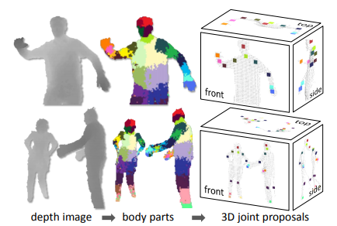
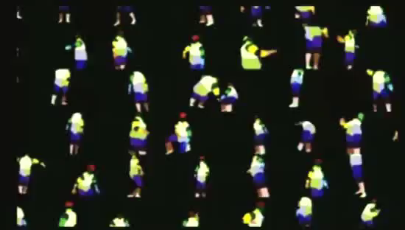
Example: Microsoft Kinect

Slide 10
Supervised Learning Process
Gather and Prepare Data
Choose a Model
Train Model
Evaluate Model
Tuning
Prediction
This is the most important/overlooked step. Without data, there is no machine learning!
In this step, we answer the following questions:
What information (i.e., features) do we need to collect?
How we are going to collect that information?
We may need thousands, or even millions of instances to effectively learn
How we are going to organize that information?
Should we randomize the data to prevent the model from considering order?
Are the labels distributed equally across instances?
How much of our data is going to be used to train the model?
How much of our data is going to be used to evaluate how well the model performs on new data?
waist | pushup | situp | run | result
40 | 36 | 55 | 676 | Unsat
42 | 67 | 25 | 798 | Unsat
30 | 44 | 58 | 568 | Ex
30 | 39 | 58 | 729 | Sat
37 | 46 | 57 | 709 | Sat
Train Dataset (80%)
Evaluate Dataset (20%)
Make sure your training and evaluation datasets have similar label distributions.

Slide 11
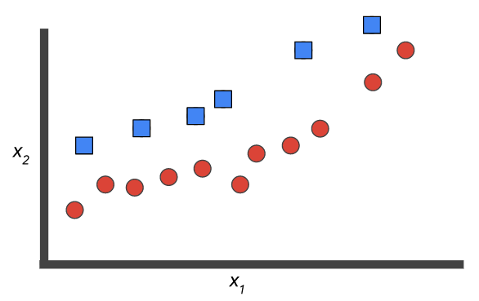
Supervised Learning Process
Gather and Prepare Data
Choose a Model
Train Model
Evaluate Model
Tuning
Prediction
There are literally hundreds of possible machine learning algorithms to choose from.
Decision Trees
Support Vector Machines
Linear/Logistic Regression
Bayes (Probabilities)
Neural Networks
Genetic Algorithms
Picking the “right” algorithm requires some understanding of the problem, as well as a little bit of intuition / experimentation
Notes:
https://machinelearningmastery.com/use-classification-machine-learning-algorithms-weka/

Slide 12
Supervised Learning Process
Gather and Prepare Data
Choose a Model
Train Model
Evaluate Model
Tuning
Prediction
This is the phase where we give the training data to the model, and let it learn
Conceptually, the algorithm is:
Looking at the features in the training data, and using them to “guess” the label
Examining the error between the “guess” and the answer (the label we provided)
Adjusting the internal weights in the algorithm
Repeat process until the error is minimized
Notes:
https://machinelearningmastery.com/use-classification-machine-learning-algorithms-weka/

Slide 13
Supervised Learning Process
Gather and Prepare Data
Choose a Model
Train Model
Evaluate Model
Tuning
Prediction
This is where we test the model with data that it has never seen before
Our goal is to get an idea of how well our model would work in the real world.
We want make sure that the model has learned the general concept, rather than memorize the answers to the test (i.e., overfitting)
We also want to look at the confusion matrix to see where the model succeeds / fails
We may end up having to retrain our model (or generate more features) if we don’t like the results.
“This was classified as Satisfactory, when it was actually Unsat.”
Predicted
Accuracy
Unsat | Ex | Sat
168 | 0 | 6 | Unsat
0 | 23 | 2 | Ex
3 | 2 | 146 | Sat
Training Dataset (80% of our total dataset)
98.6%
Actual
Evaluation Dataset (20% of our total dataset)
96.2%
Confusion Matrix
(Tells Us Where the Model Succeeds / Fails)
Notes:
https://machinelearningmastery.com/use-classification-machine-learning-algorithms-weka/

Slide 14
Supervised Learning Process
Gather and Prepare Data
Choose a Model
Train Model
Evaluate Model
Tuning
Prediction
This is where we adjust the settings on the machine learning algorithm to see if we can “tweak” the performance further.
Every machine learning algorithm has its own parameters that you can tune:
Folds: How many times you show the training data to the algorithm to let it learn
Learning Rate: How much the algorithm changes when it makes a mistake
You can spend a lot of time here, but it won’t help if your dataset isn’t good
Learning Rate
Notes:
https://machinelearningmastery.com/use-classification-machine-learning-algorithms-weka/

Slide 15
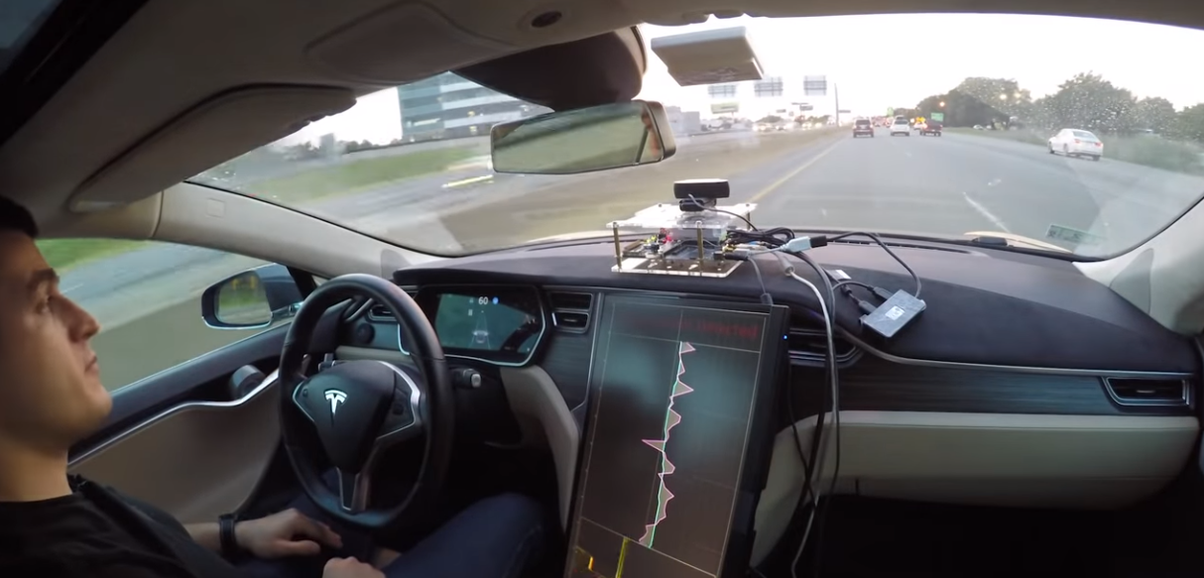
Supervised Learning Process
Gather and Prepare Data
Choose a Model
Train Model
Evaluate Model
Tuning
Prediction
This is where we use our model in the real world, with real data
The previous steps gave us confidence that the model works (or at least told us what to expect)
If we are smart, we will collect the real-world instances / predictions
We can then use that as additional training to improve our model
Notes:
https://machinelearningmastery.com/use-classification-machine-learning-algorithms-weka/

Slide 16
It’s a Lot of Work!
It is a common misconception that Machine Learning is a “set it and forget it” process.
Humans are involved in nearly every step, specifically when it comes to:
Determining how we are going to collect and label the data
Designing the training regimen such that it doesn’t introduce implicit biases
Too much of one data vs. the other
Examining the trained model to make sure it didn’t learn something irrelevant or inconsequential
Example: What if we found out that people with B+ blood types tend to get an Excellent more often?
Correlation does not (always) equal causation!

Slide 17
Lesson Review
How do I know that you learned? It’s because you can now:
Describe the goals and motivation behind Machine Learning
Define common ML terminology, such as “model”, “instance”, and “feature”
Describe and differentiate between Supervised and Unsupervised learning
Describe and execute the steps involved in training a machine learning model
Analyze a confusion matrix in order to evaluate a model’s performance

